Slide 1
2024 Arizona Legislative Report 56th Legislature – Second Session
October 2024

Slide 2
Session Overview
Opening Day: Monday, January 8, 2024 (12:00 p.m.)
Adjourned Sine Die: Saturday, June 15, 2024 (9:55 p.m.)
General Effective Date*: Saturday, September 14, 2024
*The effective date of all legislation which was passed – without an Emergency Cause or other specified effective date – and not vetoed by the Governor
Legislature Chamber and Party Dynamics
The House had significant turnover throughout the session with seven Democrat members resigning for various reason, requiring replacements to be appointed. The length of time it takes for a replacement to be appointed varied between 11 and 31 days, leaving the Democrats short votes during these periods:
Three resigned in January (01/01, 01/26, & 01/31);
One in February (02/01);
One in March (03/19);
One in April (04/04); and
One in June (06/30)
160 Days
Chamber | Democrats | Republicans | Total
House | 29 | 31 | 60
Senate | 14 | 16 | 30
Insert Presentation Title Here

Slide 3
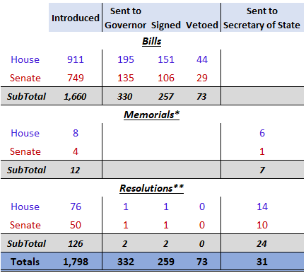
Legislation Overview
*A request/proposal presented via stated facts with direction to the named entity to act in accordance with the stated request/proposal
**Declaration of intent/resolve to amend the Arizona Constitution or conduct the business of the Legislature; expression of opinion/will in support of entities/actions/etc.; or a commemoration of the death of a prominent public figure.

Slide 4
FY 2025 Budget Overview: Arizona Department of Environmental Quality (ADEQ)
Air Quality Division
$1M appropriation from the State General Fund (GF) to ADEQ to conduct a zero-emissions heavy-duty eight-ton pilot program. HB2897, Sec.130, p.119
$2.3M transfer from the Air Quality Fund to the GF. HB2897, Sec.133, p.122
$5M transfer from the Emissions Inspection Fund to the GF. HB2897, Sec.133, p.122
Authorizes up to $400,000 from the Emissions Inspection Fund for ADEQ operating costs. HB2897, Sec.41, p.67
Reduction of vehicle emissions testing fees for Area A (statutorily defined area containing most of Maricopa county and portions of Pinal and Yavapai Counties) that will in, totality, generate a 5% overall reduction of collected revenue FY24 Area A fee revenues to the Vehicle Emissions Inspection Fund. HB2902, Sec.10, p.6
$2.7M appropriation increase in the Emissions Inspection Fund. Agency Detail Book.pdf (azospb.gov), p.157
$3.4M appropriation increase in the Air Quality Fund for Voluntary Vehicle Repair Program (VVRP) [$2.9M] and for 3.0 Full Time Employee (FTE) positions to assist with the State Implementation Plan (SIP) backlog. Agency Detail Book.pdf (azospb.gov), pp. 156-157
Insert Presentation Title Here

Slide 5
FY 2025 Budget Overview: Arizona Department of Environmental Quality (ADEQ)
Waste Division
$15M appropriation from the GF to the Water Quality Assurance Revolving Fund (WQARF). HB2902, Sec. 9, p.5
$20M transfer from the Underground Storage Tank Revolving Fund to the GF. HB2897, Sec.133, p.122
$900,000 transfer from the Hazardous Waste Management Fund to the GF. HB2897, Sec.133, p.122
$500,000 transfer from the Emergency Response Fund to the GF. HB2897, Sec.133, p.122
$950,000 appropriation increase in the Recycling Fund. Agency Detail Book.pdf (azospb.gov), pp.157-158
Authorizes up to $6.5M from the Underground Storage Tack Revolving Fund for ADEQ administrative costs and for remediating border area sewage discharge issues. HB2902, Sec.7, p.5
Requirement to report annually, starting September 1, 2024, to the Joint Legislative Budget Committee on the progress of WQARF activities (i.e. emergency response, priority site remediation, and cost recovery/revenue and expenditure/other WAQRF-funded program activities); and include a budget, developed in consultation with the WQARF Advisory Board, for the WQARF program. HB2897, Sec.41, p.66
Water Division
$7.2M appropriation from the Air Quality Fund to the Water Quality Fee Fund. HB2897, Sec.136, p.125
Insert Presentation Title Here

Slide 6
FY 2025 Budget Overview: Arizona Department of Water Resources (ADWR)
$11M FY2024 appropriation for the Brackish Groundwater Recovery Pilot Program removed; and repeals the program. HB2897, Sec.10, p.26
$100,000 FY2024 appropriation for the Brackish Water Study removed. HB2897, Sec.102, pp.106-107
$5M FY2024 appropriation for the Statewide Water Resources Planning Program removed. HB2897, Sec.102, pp.106-107
$24M FY2024 appropriation for the Groundwater Infrastructure (Santa Rosa Canal) removed. HB2897, Sec.102, pp.106-107
$500,000 reduction from the Arizona Water Protection Fund Deposit. HB2897, Sec.102, pp.106-107
$2.5M transferred from the Water Resources Fund to ADWR’s subaccount in the Automation Project Fund to be transferred to ADOA to develop, modernize, and consolidate ADWR’s applications. HB2897, Sec.115, p.109
$21,500 lump sum reduction of GF appropriation to ADWR. HB2897, Sec.129, pp.117-118
$6,000 lump sum reduction of GF appropriation to the Arizona Navigable Stream Adjudication Commission. HB2897, Sec.129, pp.117-118
$600,000 transferred from the Temporary Groundwater and Irrigation Efficiency Projects Fund to the GF. HB2897, Sec.133, p.124
$200,000 transferred from the Assured and Adequate Water Supply Administration Fund to the GF. HB2897, Sec.133, p.124
$1M transferred from the Arizona Water Protection Fund to the GF. HB2897, Sec.133, p.124
Authorizes the Arizona Water Protection Fund Commission to grant up to $336,000 of the unobligated balance in the Arizona Water Protection Fund to ADWR to use for administrative costs. HB2902, Sec.6, p.5
Authorizes Arizona Water Banking Fund monies appropriated to the Arizona Navigable Stream Adjudication Commission to be used to pay legal fees. HB2902, Sec.8, p.5
Authorizes the addition of 25.0 FTE positions – with no additional funding (ADWR has the funding for these positions; but lacked the FTE authority) – in hydrology, groundwater management, automated groundwater monitoring, assured and adequate water supply administration, new river flood insurance study programs, and operating lump sum . Agency Detail Book.pdf (azospb.gov), p.456
Insert Presentation Title Here

Slide 7
Significant Environmental Legislation ~ Air Quality
HB 2370: Oxygenated Fuel; Federal Approval; Extension (Rep. Gail Griffin, LD9)
Extends from July 1, 2024 to July 1, 2027 (while awaiting EPA to approve the related-SIP measure), the enactment deadline of statutory provisions permitting the sale of a gasoline blend, other than one only with ethanol, for mother vehicles in the Phoenix metro area between November 1 and March 31 of each year. Emergency clause requires measure to become effective upon signing.
Signed: April 2, 2024
Effective Date: April 2, 2024
HB 2628: Department of Environmental Quality; Omnibus (Rep. Gail Griffin, LD9)
Requires certain emissions tests for vehicles of certain model years and gross vehicle weight. (Sec. 6)
Modifies the conditional enactment of ARS §49-542 regarding the vehicle emissions inspection program to occur upon EPA’s approval of Arizona’s SIP. (Sec. 10)
Signed: April 10, 2024
Effective Date: September 14, 2024
Insert Presentation Title Here

Slide 8
Significant Environmental Legislation ~ Waste
HB 2367: Solid Waste; Fees; Rules (Rep. Gail Griffin, LD9)
Authorizes ADEQ to adopt rules and establish fees for solid waste programs; and removes the one-time rulemaking stipulations.
Requires collection and recycling facilities that accept lead acid batteries to register with ADEQ; and to pay an initial registration fee (deposited in the Solid Waste Fee Fund) and an annual fee.
Emergency clause requires measure become effective upon signing.
Signed: April 9, 2024
Effective Date: April 9, 2024
HB 2628: Department of Environmental Quality; Omnibus (Rep. Gail Griffin, LD9)
Removes the definition of and references to “conditionally exempt small generator waste” and replaces it with the definition of and references to “very small quantity generator waste”. (Sec. 1, 7, & 8)
Authorizes solid waste disposal sites to accept waste tires for disposal only if the practice is part of the site’s ADEQ-approved solid waste facility plan. (Sec. 2)
Authorizes the disposal of whole tires, including with or without rims, pursuant to a solid waste facility plan only if disposed in accordance with one of the two statutorily-specified manners. (Sec. 2)
Modifies the definitions of “closed solid waste facility” and “recycling facility”. (Sec. 7)
Modifies the permit application submittal timeline for a facility with a coal combustion residual unit. (Sec. 10)
Signed: April 10, 2024
Effective Date: September 14, 2024
Insert Presentation Title Here

Slide 9
Significant Environmental Legislation ~ Water Quality
HB 2195: On-Site Wastewater Treatment Facilities; Permitting (Rep. Laurin Hendrix, LD14)
Authorizes a facility, complying with existing general permit (“GP”) rules and is operated by a service provider that is certified by the technology manufacturer, with a design flow of 3,000-75,000 gal/day, to discharge under a GP; and requires the facility to perform certain ongoing actions and reporting in addition to the requirements established in the GP.
Authorizes ADEQ to require a facility with a design flow of, or a site with multiple facilities with a collective design flow of, at least 50,000 gal/day, to provide adequate financial assurance.
Requires ADEQ to establish fees for GP’s issued pursuant to the above; and to deposit the fees into the Water Quality Fee Fund.
Signed: April 10, 2024
Effective Date: September 14, 2024
NOTE: ADEQ intends to retain authority for these permits, thus will not fall under current County delegation agreements. (not an ADEQ supported bill)
HB 2369: Dredge; Fill; Permits; Cleanup (Rep. Gail Griffin, LD9)
Removes obsolete references to the conditional repeal of the Dredge and Fill Permit Program upon deciding against pursuing state primacy of the program.
Signed: April 10, 2024
Effective Date: September 14, 2024
HB 2628: Department of Environmental Quality; Omnibus (Rep. Gail Griffin, LD9)
Repeals, from Arizona’s Underground Injection Control (“UIC”) Program, the statutory application of federal definitions prescribed in UIC Program of the Safe Drinking Water Act and related implementing regulations (Sec. 3)
Authorizes the Small Drinking Water Systems Fund to include federal monies (Sec. 4)
Authorizes ADEQ to adopt rules establishing criteria for a public water system to opt out of the Monitoring Assistance Program. (Sec. 5)
Authorizes ADEQ to conduct additional sampling for a system that triggers a detection limit set by rule and in compliance with the Safe Drinking Water Act. (Sec. 5)
Authorizes the Monitoring Assistance Fund to include federal monies; and modifies the criteria by which a fund surplus is determined for the purpose of triggering a fee reduction in the subsequent year. (Sec. 5)
Signed: April 10, 2024
Effective Date: September 14, 2024
Insert Presentation Title Here

Slide 10
Significant Water Legislation
HB 2016: Grandfathered Right; Subsequent AMA; Extension (Rep. Gail Griffin, LD9)
Extends the deadline from 15 to 21 months after December 1, 2022, for a claimant to file an application for a certificate of grandfathered right to withdraw or receive and use groundwater in the Douglas AMA. Emergency clause requires measure to become effective upon signing; and a Retroactivity Clause requires effectiveness to begin February 29, 2024.
Signed: March 5, 2024
Effective Date: February 29, 2024
HB 2055: Underground Water Storage; Permitting (Rep. Tim Dunn, LD25)
Modifies permit application review timelines from 100 to 180 days; and decision issuance from six months to 100 days after giving notice of the application being administratively complete.
Signed: April 4, 2024
Effective Date: September 14, 2024
(Only ADWR supported bill)
HB 2368: Transportation; Groundwater; Douglas AMA (Rep. Gail Griffin, LD9)
Authorizes an owner, including an owner that is a private water company, of a well located in the Upper San Pedro Groundwater Basin and meets certain statutory requirements, to annually withdraw groundwater from the Basin for transportation to the Douglas AMA in a specified amount.
Signed: June 21, 2024
Effective Date: September 14, 2024
Insert Presentation Title Here

Slide 11
Significant Water Legislation (Cont.)
SB 1081: Exemption Area; Assured Water Supply (Sen. Sine Kerr, LD25)
Authorizes ADWR to designate, upon receipt of application by a city or town, a portion of a city or town that is located both in an area delineated for exemption and in the Phoenix AMA as having an assured water supply if certain criteria are met.
Signed: April 10, 2024
Effective Date: September 14, 2024
SB 1181: Groundwater Replenishment; Member Lands; Areas (Sen. Warren Petersen, LD14)
Establishes a process for a municipal provider applying for a new designation of assured water supply in the Phoenix AMA that relies on a member service area agreement to elect for all parcels of member land to retain a replenishment obligation. Session law requires that ADWR amend its rule for the incorporation of extinguishment credits and groundwater allowance associated with member lands in a designation of assured water supply consistent with the replenishment obligations by January 1, 2025.
Signed: June 19, 2024
Effective Date: September 14, 2024
SB 1242: Water Conservation Grant Fund; Purpose (Sen. T.J. Shope, LD16)
Authorizes, and establishes a process in which, eligible entities (the State, a political subdivision thereof, or a public service corporation regulated by the ACC and has a certificate of convenience and necessity for water service) to transport groundwater away from the Harquahala INA to be received and used in an initial AMA for use by an eligible entity or the Arizona Water Banking Authority, or in La Paz County for use by eligible entity.
Signed: June 19, 2024
Effective Date: September 14, 2024
Insert Presentation Title Here

Slide 12
Significant Public Lands Legislation
HB 2548: Military Installations; General Plans; Land (Rep. Kevin Payne, LD27)
Requires that in developing a General Plan, political subdivisions with any portion of an influence area (all property within two miles of the exterior perimeter or fence line) of a military installation/range or Arizona National Guard site to identify the boundaries of the influence area for the purposes of planning land uses in the influence area that are compatible with the operations thereof.
Signed: March 29, 2024
Effective Date: September 14, 2024
HB 2865: Natural Resource Conservation Districts; Board (Rep. Gail Griffin, LD19)
Establishes The State Natural Resource Conservation Board of eight Arizona residents: at least six of the members must be elected supervisors for a Natural Resource Conservation District (“NRCD”); no more than two members may be appointed supervisors from a Soil and Water Conservation District; at least one member shall be a member of the Executive Board of a statewide organization that represents all Arizona NRCDs; and three members, appointed by the Governor, from ASLD, ADA, State Forester, or AZGFD.
Transfers oversight of the NRCDs from ASLD to the Board, as of December 31, 2024.
Signed: June 21, 2024
Effective Date: September 14, 2024
SB 1079: State Land Auctions; Electronic Means (Sen. Sine Kerr, LD25)
Authorizes ASLD to accept bids offered through electronic means during a public auction. Requires ASLD to adopt rules to prescribe a procedure, method, and means for the sale of state lands through electronic means.
Signed: June 21, 2024
Effective Date: September 14, 2024
Insert Presentation Title Here

Slide 13
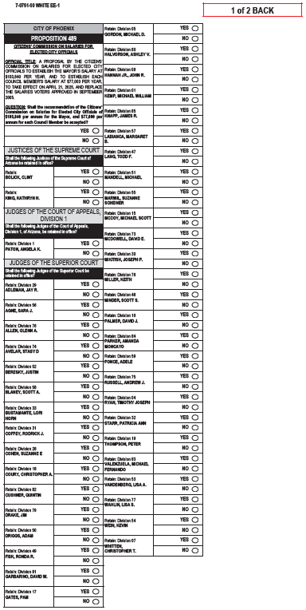
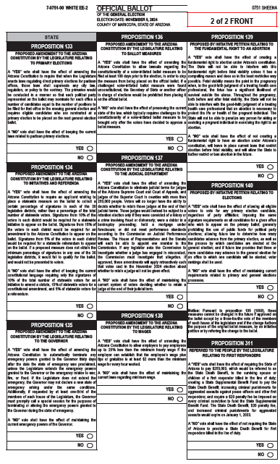
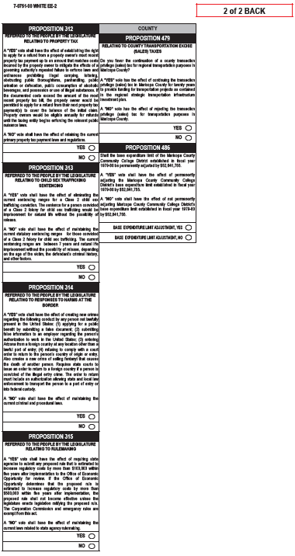
2024 General Election Overview

Slide 14
November 2024 Ballot Measures: Constitutional Referrals
PROPOSTION 133 - Primary Elections; Eligible Candidates [HCR2033 (2023) Rep. Austin Smith, LD29] Amends the Constitution to require that the state direct primary election law supersedes any inconsistent or contrary local election law. Permits each qualified political party to have for representation on the ballot, the ability to nominate the same number of candidates for the office as the number of positions to be filled for that office in the next general election; and that the nominated candidates be placed on the official ballot in the next general election.
PROPOSITION 134 – Initiative; Referendum; Signatures; Legislative Districts [SCR1015 (2023) Sen. J.D. Mesnard, LD13] Amends the Constitution to require that the signature requirements for statewide measures contain a minimum percentage of the qualified electors in each of the 30 legislative districts.
- constitutional amendment initiatives: at least 15 percent
- statutory amendment initiatives: at least 10 percent
- referendums: at least five percent
PROPOSITION 135 – Governor; Emergency; Powers [HCR2039 (2023) Rep. Joseph Chaplik, LD3] Amends the Constitution to require that the emergency powers granted to the Governor during the state of emergency (except for powers related to a state of war emergency or an emergency arising from a flood or fire) terminates after 30 days, or earlier by proclamation of the Governor or by concurrent resolution of the legislature. Permits the extension of the emergency powers upon the passage of a concurrent resolution by the Legislature.
PROPOSITION 136 – Ballot Measures; Challenges [SCR1041 (2024) Sen. J.D. Mesnard, LD13]
Authorizes, and establishes a process, for any person to challenge in Superior Court and no later than 100 days before the Election, the constitutionality of proposed initiative measures or amendments filed with the Secretary of State.
PROPOSITION 137 – Judicial Accountability Act of 2024 [SCR1044 (2024) Sen. David Gowan, LD19]
Amends the judicial retention provision of the Arizona Constitution by permitting State Supreme Court Justices, Intermediate Appellate Courts Judges, and Superior Court judges (in counties with a population greater than 250,000) to hold office indefinitely during good behavior; and requiring a vote of retention only in specified circumstances.
PROPOSITION 138 – Tipped Workers Protection Act [SCR1040 (2024) Sen. J.D. Mesnard, LD13]
Permits employers, for employees who customarily and regularly receive tips/gratuities from patrons/other that equate to minimum wage plus $2 for all hours worked for each week, the ability to reduce wages by up to 25% of the statutorily established minimum wage.

Slide 15
November 2024 Ballot Propositions: Initiatives
PROPOSITION 139 - Arizona Abortion Access Act [I-05-2024 (Constitutional Amendment Measure) Arizona for Abortion Access]
Amends the Constitution to expressly state that every individual has a fundamental right to abortion; and prohibits the ability to limit or restrict this right in any manner.
PROPOSITION 140 - Make Elections Fair Arizona Act [I-14-2024 (Constitutional Amendment Measure) Make Elections Fair PAC]
Amends the Constitution to allow for voter rankings in elections to determine which candidates receive the highest number of legal votes. Eliminates partisan primary ballots and establishes a process in which all candidates are on one ballot.

Slide 16
November 2024 Ballot Measures: Statutory Referrals
PROPOSITION 311 – Back the Blue Act [SCR1006 (2023), Sen. David Gowan, LD19] Establishes a means and process by which the state will pay a State Death Benefit of $250,000 to the family of a first responder who was killed in the line of duty. Establishes a State Supplemental Benefit Fund, managed by the State Treasure, to collect a $20 penalty fee accessed on every conviction for a criminal offense.
PROPOSITION 312 - Property Tax; Refund; Nuisance Enforcement [HCR2023 (2024) Rep. Ben Toma, LD27]
Establishes the option and process for a property owner to apply for a primary property tax refund for documented expenses incurred by property owner to mitigate effects resulting from the local government’s certain policies or pattern of practices declining to enforce existing laws or maintains a public nuisance.
PROPOSITION 313 - Sex Trafficking; Child; Natural Life [SCR1021 (2024) Sen. Shawnna Bolick, LD2]
Requires that a person convicted of a Class 2 felony for child sex trafficking to be sentenced for natural life without eligibility for any form of release.
PROPOSITION 314 – Secure the Boarder Act [HCR2060 (2024) Rep. Ben Toma, LD27]
Empowers law enforcement to arrest any person who enters Arizona without going through official ports of entry. Establishes that it is a criminal offense for a person knowingly presenting false documents to obtain public benefits or evade e-verify. Requiring the use of systematic alien verification or entitlements program in verifying eligibility for a person to receive public benefits. Strengthening punishments for a person knowingly selling fentanyl which results in the death of another person.
PROPOSITION 315 - Rulemaking; Legislative Ratification; Regulatory Costs [SCR1012 (2024) Sen. Anthony Kern, LD27]
Establishes a process for legislative ratification of rule proposals estimated to increase regulatory costs by over $500,000 within five years. Requires a proposed rule estimated to increase regulatory costs by more than $100,000 within five years be submitted to the Office of Economic Opportunity (“OEO”) for review; and for the OEO to then submit to the Administrative Rules Oversight Committee (“AROC”), rule proposals it has confirmed will increase regulatory costs by over $500,000 within five years. Prohibits agencies from finalizing rules under AROC’s review until the agency receives legislative approval.

Slide 17
Amanda A. Reeve
Environmental & Regulatory Policy Advisor Snell & Wilmer areeve@swlaw.com

